Slide 1
Redundancy
Redundancy in digital images refers to unnecessary or repetitive information, such as duplicated patterns, colors, or textures that don’t significantly contribute to the image’s meaning or quality.
Detecting and reducing redundancy is vital for optimizing file sizes, efficient data transfer, and improved user experiences, especially when using web pages, where faster loading time is essential.

Slide 2
Image Redundancy
There are three main types of redundancy:
Coding Redundancy
Interpixel Redundancy
Psychovisual Redundancy(Irrelevant Information)

Slide 3
Coding Redundancy
  It is the unnecessary use of more bits than needed to represent pixel intensity values.
  A code is a system of rules mapping source symbols (e.g., gray levels in an image) to a sequence of bits.
  Each piece of information or event is assigned a sequence of code symbols, called a code word. The number of symbols in each code word is its length.
  The 8-bit codes that are used to represent the intensities in most 2-D intensity arrays contain more bits than are needed to represent the intensities.

Slide 4
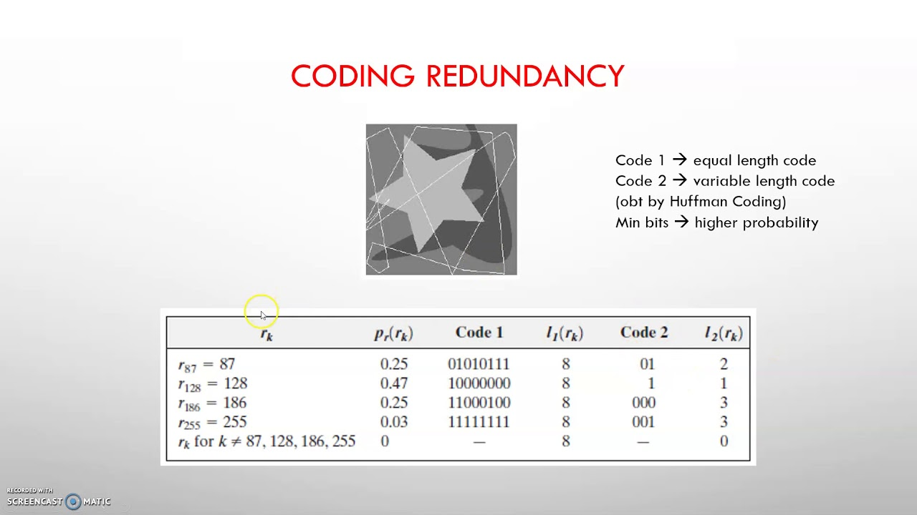

Slide 5
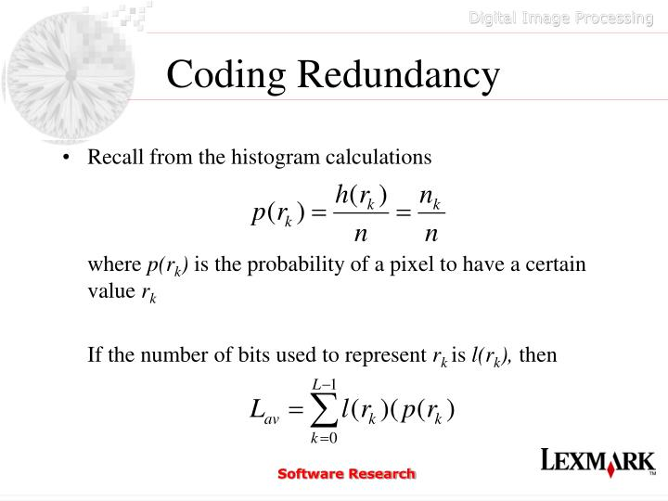

Slide 6
.
Compression Ratio(C) measures data reduction, calculated as original data size(n1) divided by compressed size(n2).
C= n1/n2
Redundancy is measured as
𝑅=1−(1/𝐶),
where 𝐶 is the compression ratio.
If 𝐶=1
(i.e., 2/2 or 1/1), there is no redundancy

Slide 7
It is also known as intraframe redundancy and involves repeating similar or identical pixel values within an image. This redundancy occurs when neighboring pixels or regions contain redundant information, such as uniform backgrounds or patterns.
Interpixel Redundancy
  Arises because neighboring pixels are often correlated, where adjacent pixels often share similar color or intensity values. It represents unnecessary, repetitive data within a single image, such as a large, uniform blue sky. In such an image, a pixel at any point in the sky is almost guaranteed to have the same or very similar intensity value as the pixel directly next to it.
  If a 100×100 pixel area is solid blue, the computer stores 10,000 individual pixels, each with the exact same color value (e.g., RGB: 0, 0, 255).

Slide 8
Psychovisual Redundancy
is the irrelevant information in images that refers to any data or elements that do not contribute meaningfully to the image’s intended message or quality. This type of redundancy exists because human perception does not involve quantitative analysis of every pixel in the image.
The human eye is much more sensitive to changes in brightness (luminance) than it is to changes in color (chrominance).

Slide 9


Slide 10
Interpixel redundancy is categorized based on the nature of the correlation within data structures:
Spatial Redundancy (Intra-frame): Correlation between neighboring pixels within a single, static image, often caused by smooth color transitions or textures i.e it occurs when adjacent pixels in an image share similar intensity or color values, making much of the data repetitive and unnecessary.
  A classic example is a digital photo of a clear blue sky, where thousands of neighboring pixels have almost identical color values.

Slide 11
Spectral Redundancy (Inter-plane):
It refers to the existence of highly correlated or identical information across different bands, channels, or frequencies within a dataset where information in one band can be predicted from another.
A primary example is in RGB images, where high red intensity often correlates with high green intensity, making it redundant to store full information for all channels.

Slide 12
Techniques like JPEG use this redundancy to reduce data size by discarding color information that is less noticeable to the human eye, without significantly degrading the image quality.

Slide 13
Temporal Redundancy (Inter-frame):
Correlation between adjacent frames in a video sequence, where background and objects remain relatively consistent over time.
  In a video of a car driving across a scene, the pixels representing the car move slightly in each frame, while the surrounding background stays the same.

Slide 14
Data Redundancy is one of the fundamental component of Data Compression.
The Data Compression reduces file size for efficient storage and transmission by removing redundant data, using techniques like Run-Length Encoding (RLE), Huffman Coding. It involves encoding an image into fewer bits and then decoding it back.

